Slide 1
Supermarket
Sales
by Benoist Légal

Slide 2


Basic dataset & Cleaning process
17 COLUMNS X 1001 ROWS
Invoice ID / Branch / City / Customer type / Gender
Product line / Unit price / Quantity / Tax 5% / Total
Date / Time / Payment / Cogs / Gross Margin Percentage / Gross Income / Rating
Cleaning process :
Rename columns using the dictionary
Normalize column titles by converting to lowercase and removing leading/trailing whitespaces
Dictionary to map old column names to new normalized column names
Drop rows with missing values (if needed)
Convert date and time columns to datetime objects with specified formats
Remove duplicates
Save the cleaned DataFrame to a new CSV file (optional)

Slide 3
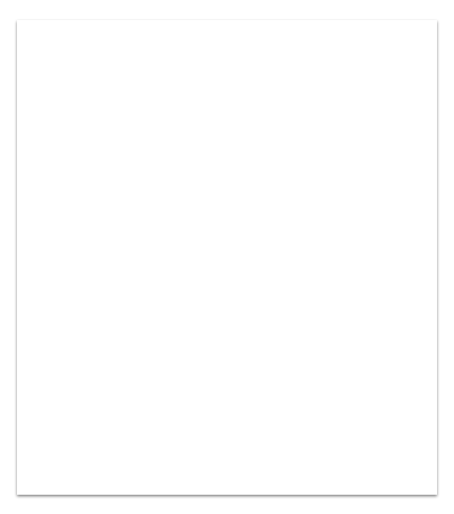
With the given supermarket sales dataset, we can analyze various aspects related to the sales transactions and gain valuable insights into the performance of the supermarket.
3 cities where in this dataset :
Yangon / Naypyitaw / Mandalay
As requested 12 steps to perform this analysis were done.

Slide 4
1. Sales by City
2. Customer Segmentation
3. Popular Product Categories
4. Top Selling Products
5. Sales Trend
6. Payment Methods Analysis
12 Steps
7. Gross Margin Analysis
8. Customer Rating Analysis
9. Average Transaction Value
10. Customer Retention Rate
11. Time Analysis
12. Sales Correlation

Slide 5
Let’s check on 3 areas
Total sales by product line and gender
Customer Rating Analysis
Sales by City
By going into these three areas, the supermarket can gain valuable insights that enable data-driven decision-making and optimization of business operations.
Continuous monitoring and analysis of these metrics will facilitate improvements in various aspects of the business, leading to enhanced customer satisfaction, increased revenue, and overall growth

Slide 6
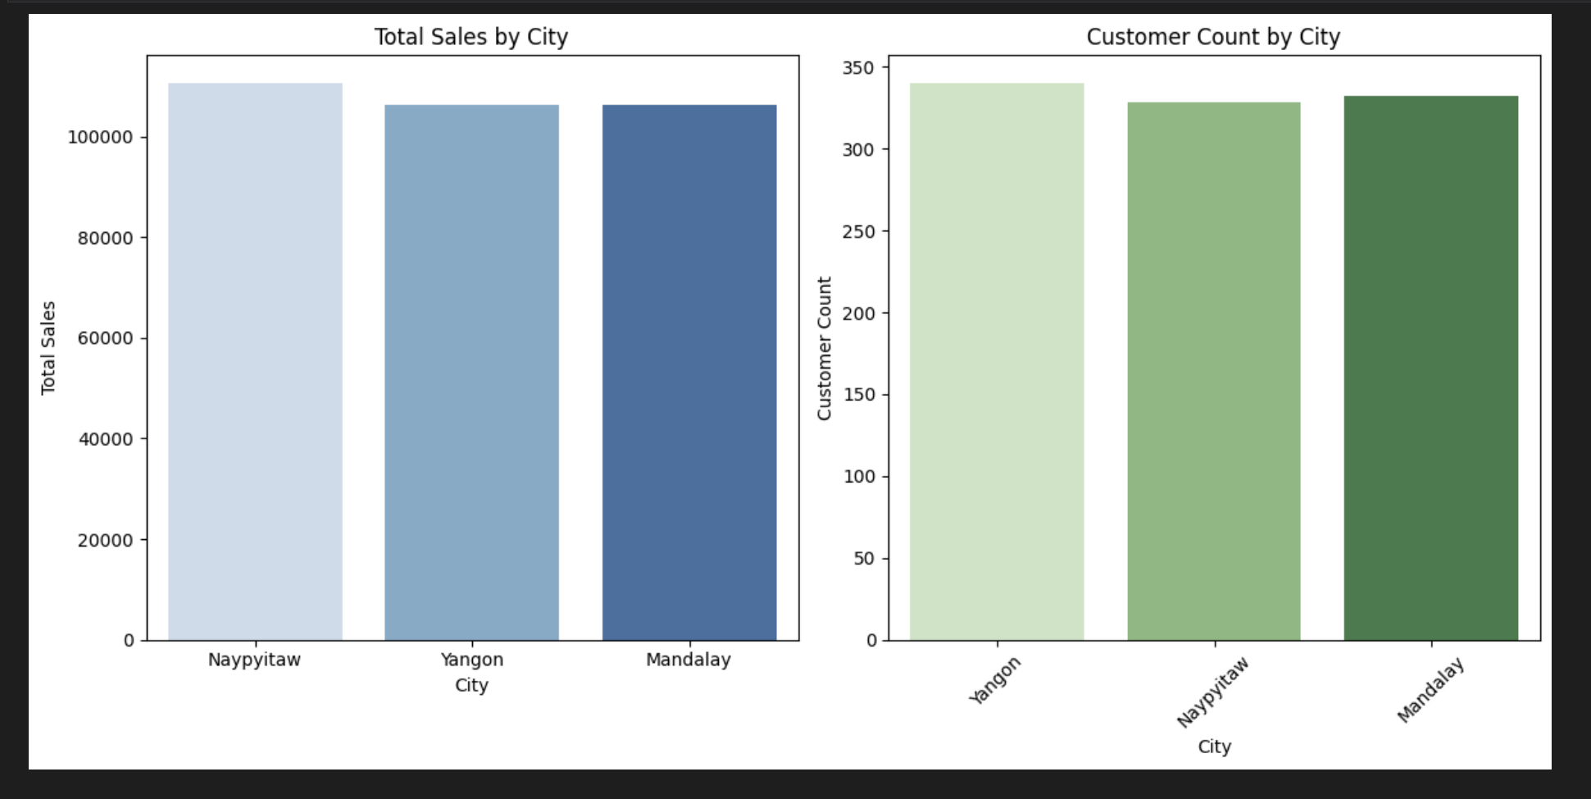
For understanding the geographic distribution of the sales and can help in making informed decisions about marketing strategies, stock allocation, and expansion plans.
For example, if one city is consistently generating higher sales and has more customer activity, it might be worthwhile to invest more resources and marketing efforts in that location to maximize profits.
Sales by City

Slide 7
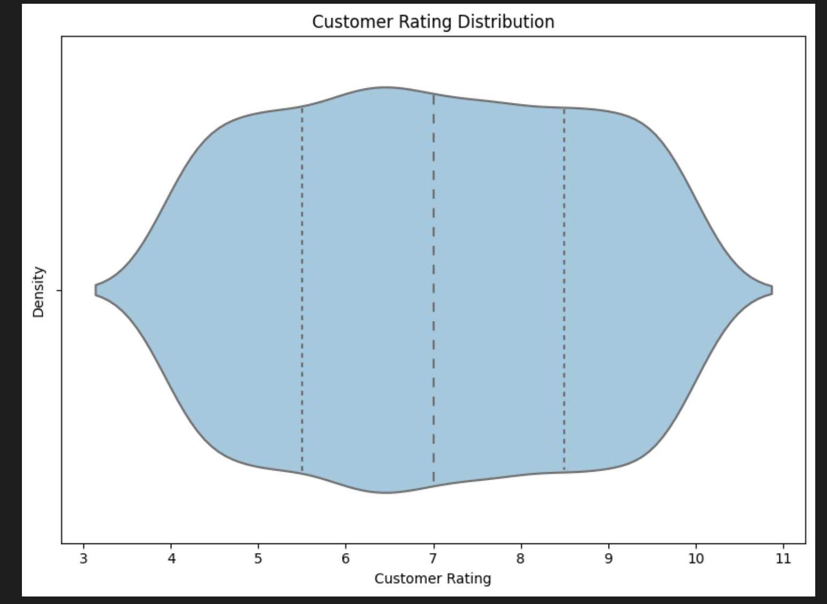
Customer Rating Analysis
Examining the distribution of customer ratings allows us to gauge customer satisfaction.
A high average rating indicates that customers are generally satisfied with the products and services offered by the supermarket.
A lower average rating may highlight areas that require improvement, such as customer service, product quality, or overall shopping experience.

Slide 8
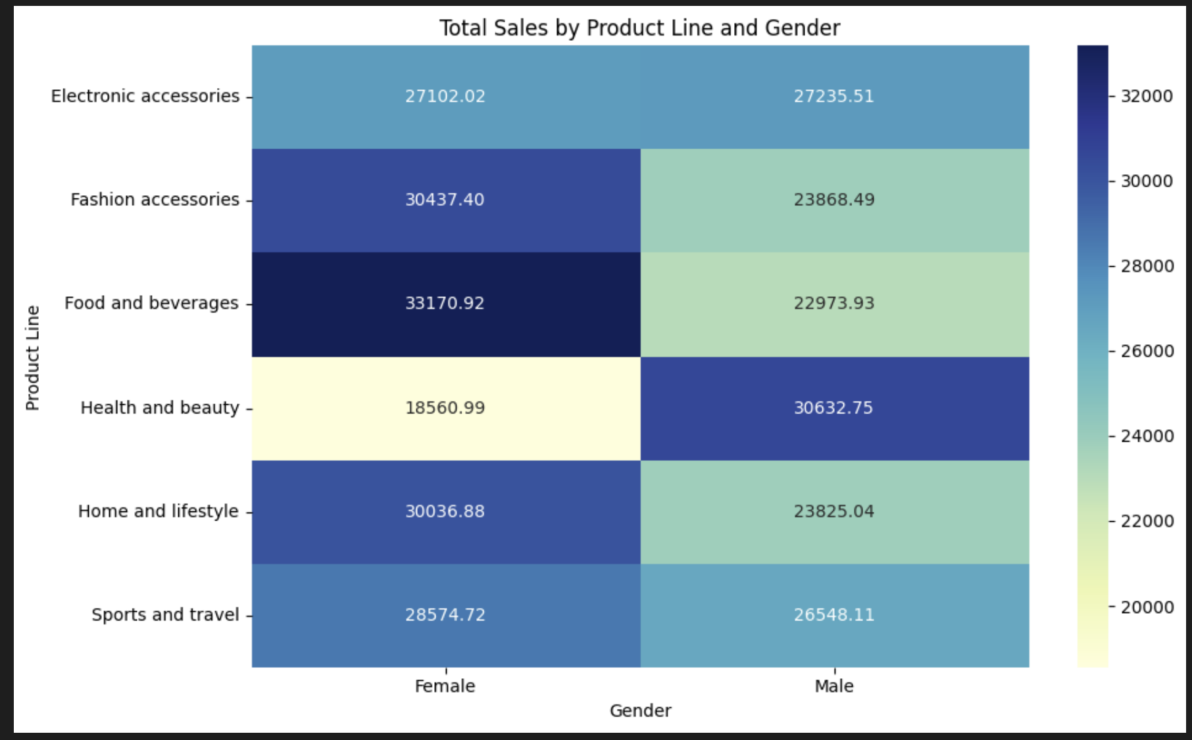
Helps to identify the most popular product categories among different customer segments. Its valuable for tailoring marketing strategies and product offerings to specific target audiences.
Helps the promotions and advertising campaigns that resonate with that demographic.
Can guide inventory management decisions and resource allocation to maximize profitability.
Total sales by product line and gender

Slide 9
With those 3 areas, the supermarket can gain valuable insights that enable data-driven decision-making and optimization of business operations.
Continuous monitoring and analysis of these metrics will facilitate improvements in various aspects of the business, leading to enhanced customer satisfaction, increased revenue, and overall growth.

Slide 10
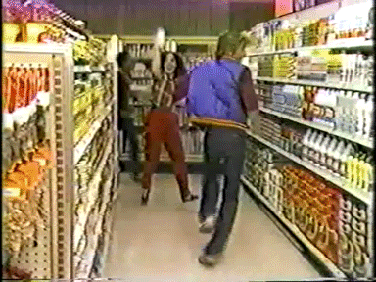
THANK YOU

